Slide 1
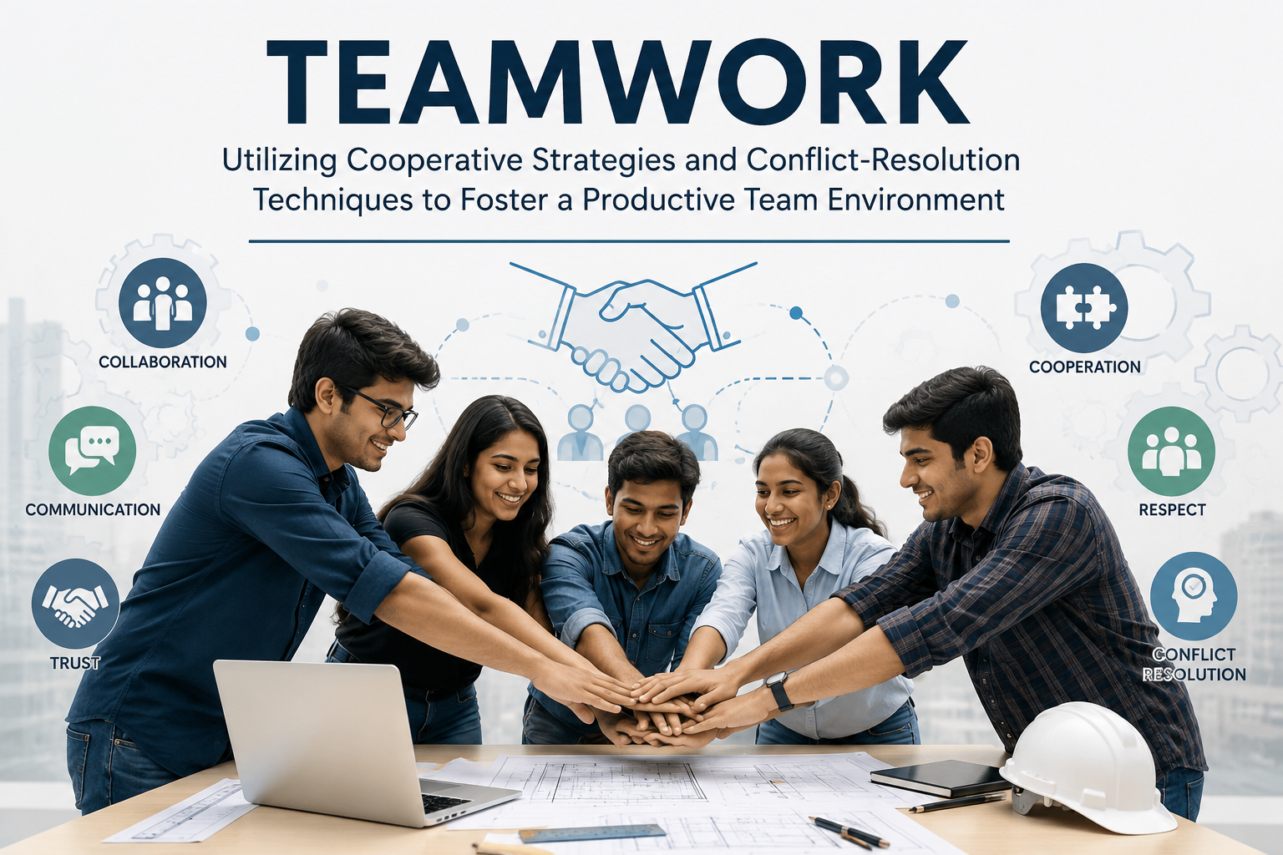
Teamwork: Utilizing Cooperative Strategies
Dr Martha Karunakar
25.06.2026
Notes:
Line spacing + Page numbers

Slide 2
Objective
Define teamwork and explain its importance in engineering.
Identify the characteristics of an effective team.
Apply cooperative strategies to improve collaboration.
Recognize common causes of conflict in teams.
Use appropriate conflict-resolution techniques to resolve
workplace disagreements.
Develop interpersonal skills essential for engineering careers.

Slide 3
Introduction -Teamwork
Teamwork is the collaborative effort of individuals working together toward a common goal by sharing knowledge, skills, and responsibilities.
Teamwork is the process of cooperating with others to achieve objectives more effectively than individuals working alone.

Slide 4
Characteristics of an Effective Team
Clear Goals: Every member understands the team's objectives.
Defined Roles: Each member knows their responsibilities.
Open Communication: Ideas and concerns are shared freely.
Mutual Trust: Members rely on one another and respect each other's contributions.
Accountability: Each member accepts responsibility for assigned tasks.
Diversity: Different perspectives lead to creative and innovative solutions.

Slide 5
Benefits of Teamwork
Effective teamwork leads to:
Improved problem-solving
Greater innovation
Faster project completion
Better decision-making
Reduced workload
Increased learning opportunities
Higher employee satisfaction

Slide 6
Stages of Team Development
(Bruce Tuckman's Model)
1. Forming: Team members meet.
Roles are unclear.
Members are polite and cautious.
2. Storming: Differences emerge.
Conflicts may occur.
Leadership begins to develop.
3. Norming: Members establish trust.
Roles become clearer.
Cooperation increases.

Slide 7
Stages of Team Development
(Bruce Tuckman's Model)
4. Performing
Team functions efficiently.
Members solve problems together.
Productivity is high.
5. Adjourning
Project concludes.
Team disbands.
Members evaluate outcomes.

Slide 8
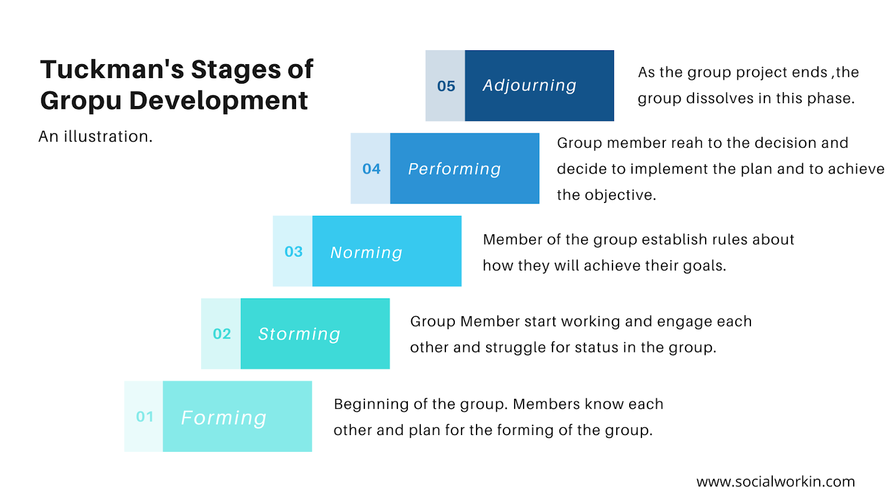

Slide 9
Conflict-Resolution Techniques to Foster a Productive Team Environment
02

Slide 10
What is conflict?
Conflict is a disagreement between individuals or groups due to differences in:
Opinions
Goals
Values
Resources
Communication styles
Conflict is not always negative.
When managed effectively, conflict can generate new ideas, Improve decisions
& Strengthen relationships

Slide 11
Conflict-Resolution Techniques
Collaboration (Win-Win)
Both parties work together to find the best solution.
Best for:
Important decisions
Long-term relationships
Example: Two engineers compare design options using performance data before choosing the best solution.

Slide 12
Conflict-Resolution Techniques
Compromise
Each party gives up something.
Best for:
Time-sensitive decisions
Example:
Both engineers agree to combine features from two designs.

Slide 13
Conflict-Resolution Techniques
Accommodation
One person accepts another's viewpoint.
Useful when:
The issue is minor.
Maintaining harmony is more important.

Slide 14
Conflict-Resolution Techniques
Avoidance
Delay discussing the issue.
Useful only when:
More information is needed.
Emotions are high.
Not suitable for long-term problems.

Slide 15
Conflict-Resolution Techniques
Competition
One person insists on their solution.
Useful only:
During emergencies
When quick decisions are essential

Slide 16
Best Conflict-Resolution Practices
✔ Focus on the problem, not the person.
✔ Listen before responding.
✔ Stay calm.
✔ Respect different opinions.
✔ Use evidence instead of emotions.
✔ Look for common goals.
✔ Document important decisions.

Slide 17
Engineering Case Study
Scenario
A team is developing a smart irrigation system.
Members:
Software engineer
Electronics engineer
Mechanical engineer
Project manager
Problem: The software team requests additional sensors.
The hardware team argues that this will exceed the budget.

Slide 18
Role-Play Activity
Scenario: Two teammates disagree on which programming language to use for a project.
One student argues for Python because of rapid development.
The other argues for Java because of scalability.
The class identifies which conflict-resolution strategy (collaboration, compromise, accommodation, avoidance, or competition) is being used and discusses whether it is appropriate.

